Slide 1








Lesson 1. Java Script

Slide 2
Client Side v/s Server Side Validation
Client side validation can be very easily bypassed by disabling JavaScript on a client browser.
If JavaScript is disabled and if we don't have any server side validation, there could be different threats ranging from storing invalid data to security vulnerabilities.
Client-side validation provides better user experience as it reduces the unnecessary round trips between the client and the server. So client side validation is nice to have.
However, if JavaScript is disabled or if the user is making a request using tools like fiddler we still want to validate the form before saving data. So, server side validation should always be there irrespective of whether we have client side validation or not.

Slide 3
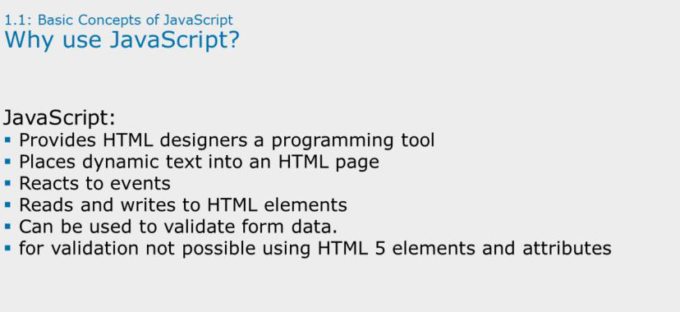

Slide 4
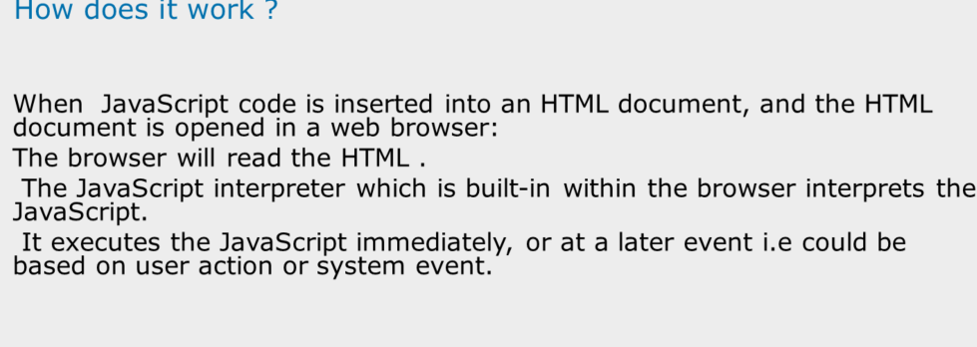
Notes:
How does JavaScript work?
When a JavaScript is inserted into an HTML document, the JavaScript interpreter which is built-in within the Internet browser will read the HTML and interpret the JavaScript. The JavaScript can be executed immediately, or at a later event.

Slide 5
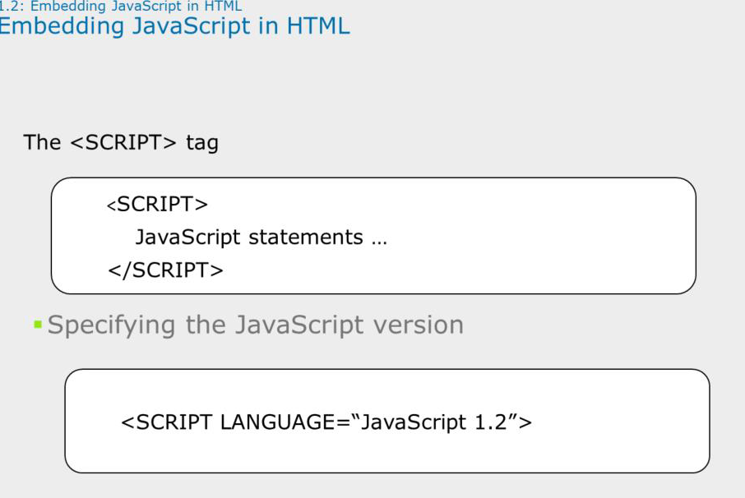
Notes:
Embedding JavaScript in HTML:
The <SCRIPT> tag is an extension to HTML that can enclose any number of JavaScript statements as shown on the slide.
A document can have multiple <SCRIPT> tags, and each can enclose any number of JavaScript statements.
The Script tag has the following attributes:
Language –This attribute specifies the scripting language. It can have values like VBScript, JavaScript. Optionally you can also specify the scripting language version as mentioned on the slide.
Type –Specifies the MIME type of the scripting language
Src–This attribute is for specifying the path and filename of an external .jsfile which contains the script code.
Some browsers may not support JavaScript and the JavaScript code is displayed as page content. To prevent this, the HTML comment should be used which will hide the JavaScript as shown on the slide. Note the two forward slashes at the end of the comment line. This is JavaScript comment symbol which prevents JavaScript from executing the --> tag.
Note that Javascriptis a case-sensitive scripting language.

Slide 6
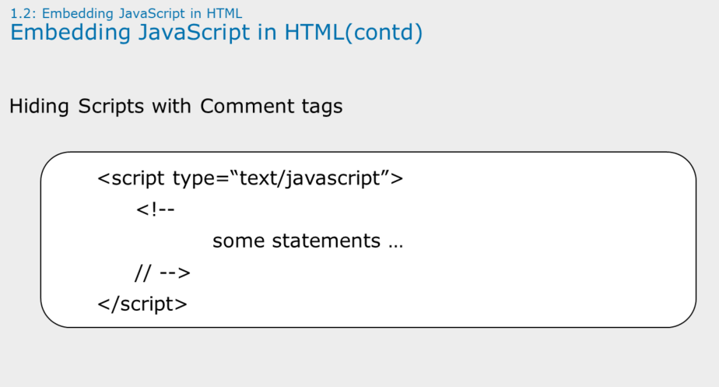

Slide 7
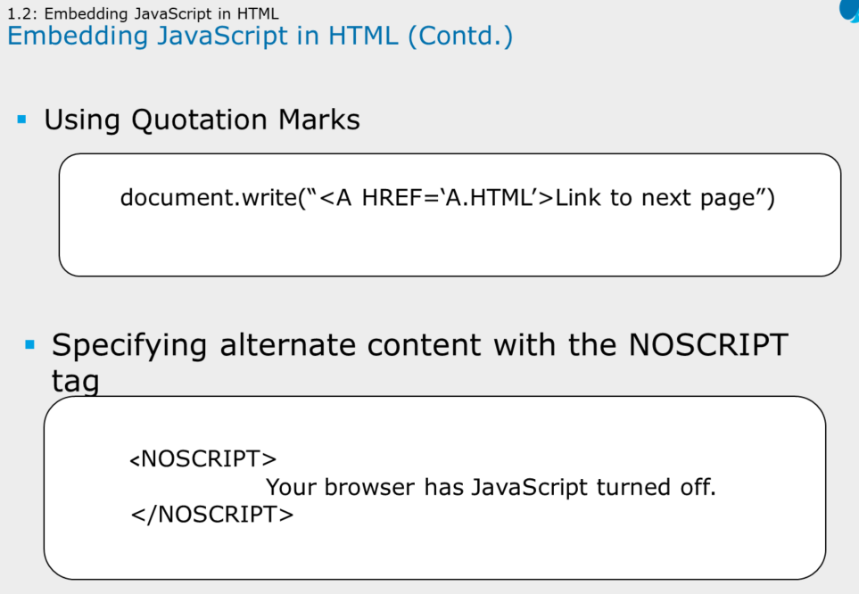

Slide 8
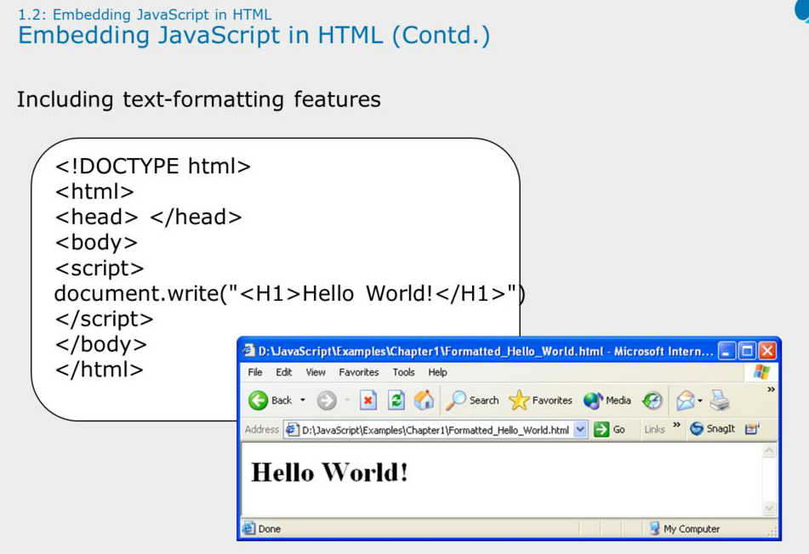

Slide 9
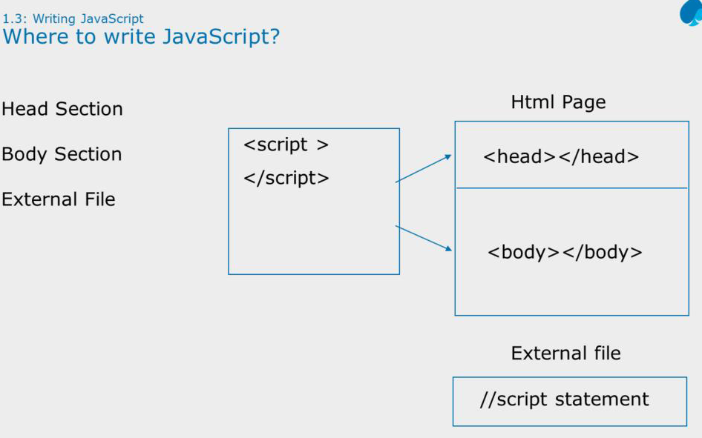
Notes:
Embedding JavaScript in HTML: Where to Write JavaScript?
Physically the script code can be placed at three different places in the html file.
Head Section: If you want the Scripts to be executed when they are called, or whenever a user action happens, put script tag in the head section.
Body Section : If you want the Scripts to be executed when the page loads then put script tag in the body section
External File : If you want to run the same JavaScript on several pages, without having to write the same script on every page, you can write a JavaScript in an external file.

Slide 10
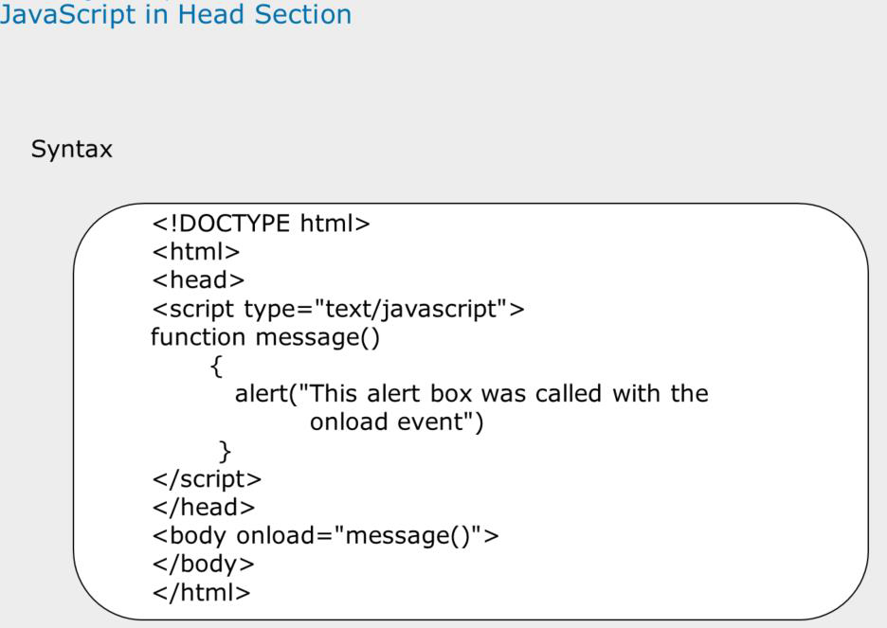
Notes:
Where to Write JavaScript? In the Head Section:
Head Section : JavaScriptsin an HTML page will be executed when the page loads. This might always not be the case. Sometimes we want to execute a JavaScript when an event occurs, such as when a user clicks a button. In such scenarios, we can put the script inside a function. Scripts that contain functions go in the head section of the document. Then we can be sure that the script is loaded before the function is called.
The example shown on the slide shows the following output:

Slide 11
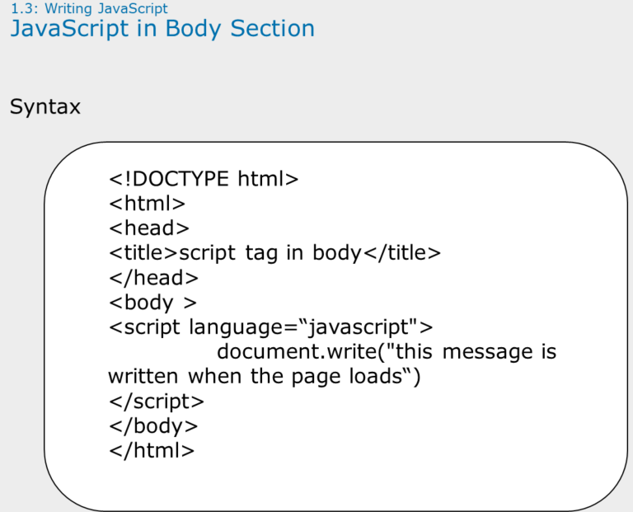
Notes:
Where to Write JavaScript? In the Body Section:
Body Section : Execute a script that is placed in the body section. The example on the slide shows script written in the body section.
And it produces this output:

Slide 12
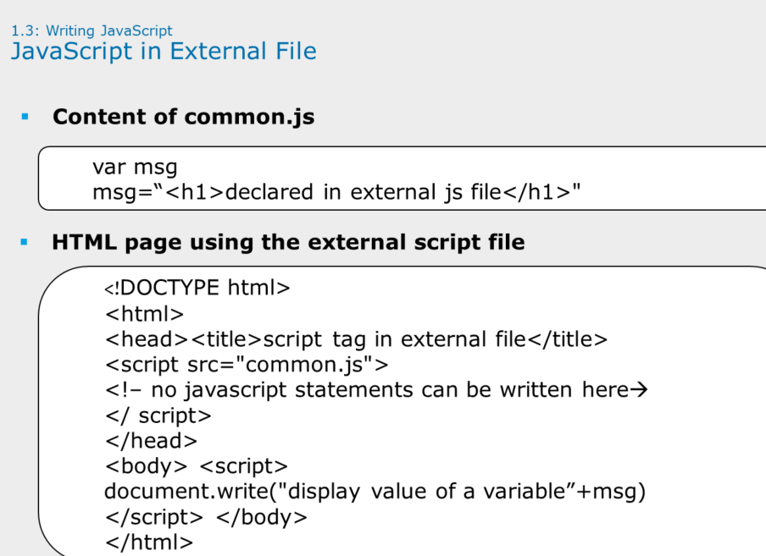
Notes:
WheretoWriteJavaScript?InExternalFile:
TheexampleontheslidedemonstrateshowtowriteJavaScriptcodeinanexternalfile.Theextensionoftheexternalfilehastobe.jsandtheitdoesnotcontainthescripttag

Slide 13
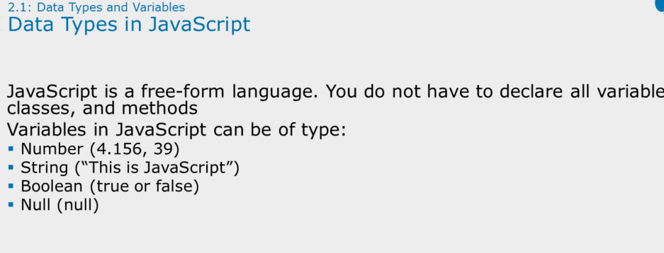
Notes:
Data Types in JavaScript:
Although the number of data types is small, they are sufficient for the tasks that JavaScript performs. Notice that there is no distinction between integers and real numbers; both types are just numbers. JavaScript does not provide an explicit data type for a date. However, there are related functions and a built-in date object that enable the Web page designer to manage dates.

Slide 14
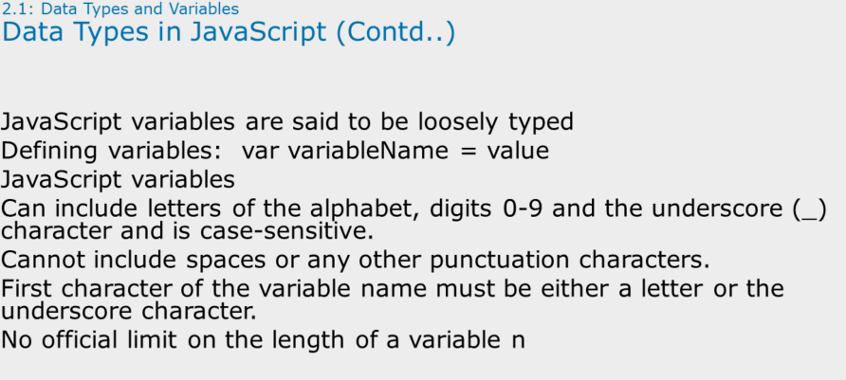

Slide 15
Disadvantages of JavaScript
There are two main disadvantages of JavaScript
Security : JavaScript runs on the client machine. So a malicious user may use JavaScript to do a variety of things like tracking your browsing history, stealing passwords etc. This is one of the main reasons why people disable JavaScript.
Browser Compatibility : Not all browsers treat the same piece of JavaScript in the same manner. This means the functionality and the user interface may vary from browser to browser. That is why cross-browser testing is very important. However, with JavaScript libraries like jQuery Browser Compatibility is no longer a major issue.
Example 1 : innerText property is supported in IE & Chrome, but not in Firefox. This means the ValidatForm() JavaScript function that we worked with in Part 1, will only work in IE & Chrome but not in Firefox. For this function to work in all the browsers (IE, Chrome & Firefox), replace innerText property with textContent

Slide 16
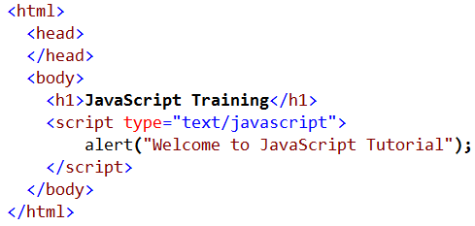
Tools for learning JavaScript
Tools required to learn JavaScript
To learn JavaScript all you need is a text editor like NOTEPAD and a browser. You can use any browser Chrome, Internet Explorer or Firefox
Copy and paste the following HTML and JavaScript in a notepad. Save it with a .HTM or .HTML extension and open with your favourite browser

Slide 17
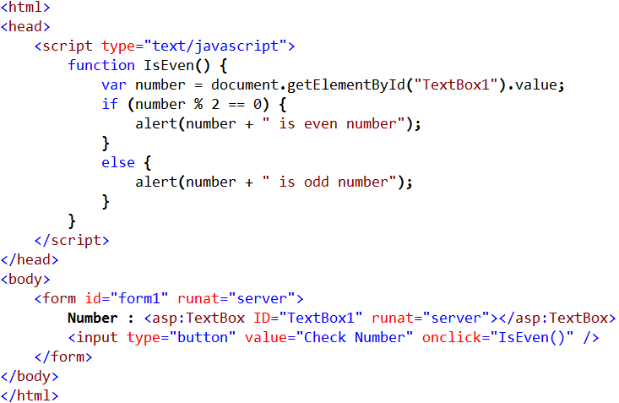
Inline vs External JavaScript
JavaScript can be stored either inline on the page or in an external .js file
Inline JavaScript Example :

Slide 18
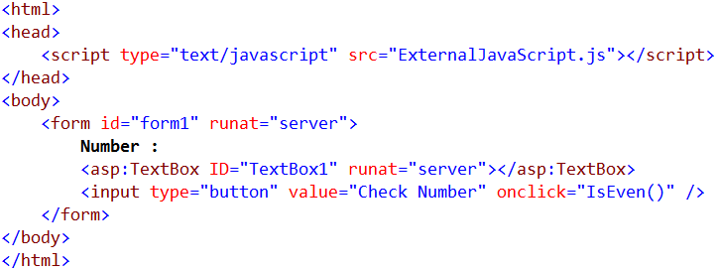
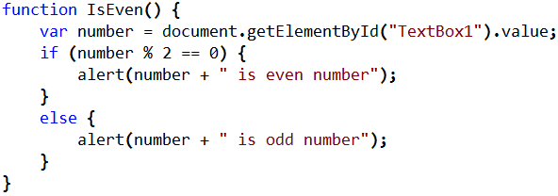
Inline vs External JavaScript
External JavaScript Example :
External JavaScript.js

Slide 19
Inline vs External JavaScript
Advantages of external JavaScript over inline JavaScript :
Maintainability : JavaScript in external files can be referenced on multiple pages without having to duplicate the code inline on every page. If something has to change, you only have one place to change. So external JavaScript code can be reused and maintenance will be much easier.
Separation of Concerns : Storing JavaScript in a separate external .js file adheres to Separation of concerns design principle. In general it is a good practice to separate HTML, CSS and JavaScript as it makes it easier working with them. Also allows multiple developers to work simultaneously.
Performance : An external JavaScript file can be cached by the browser, where as an inline JavaScript on the page is loaded every time the page loads.

Slide 20
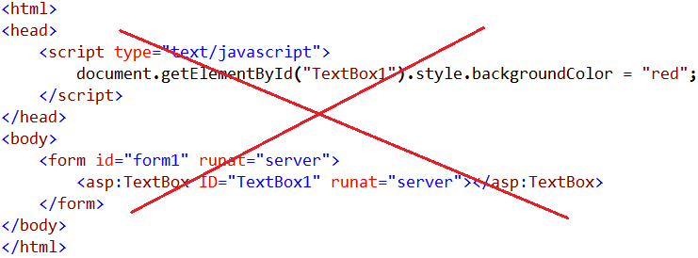
Where should the script tag be placed
Should the <script> tag be placed in the body or head section of the page. In general the <script> tag can be placed either in the head or body section.
Why did the JavaScript did not work in this case
JavaScript code is present before the textbox control. By the time the JavaScript code is executed, the textbox is still not loaded into browser DOM (Document Object Model). This is the reason JavaScript can't find the textbox and throws a NULL reference error.

Slide 21
Where should the script tag be placed
If the JavaScript is present in an external file and if you are referencing it on a page using <script> element, where should such <script> element be placed.
To answer this question, first let's understand what happens when a browser starts loading a web page.
1. The browser starts parsing the HTML
2. When the parser encounters a <script> tag that references an external JavaScript file. The parser stops parsing the HTML and the browser makes a request to download the script file. Until the download is complete, the parser is blocked from parsing the rest of the HTML on the page.
3. When the download is complete, that's when the parser will resume to parse the rest of the HTML.
This means the page loading is stopped until all the scripts are loaded which affects user experience.

Slide 22
Where should the script tag be placed
In general, the suggested good practice is to place the <script> tag just before the closing <body> tag, so it doesn't block the HTML parser.
However, modern browsers support async and defer attributes on scripts. These attributes tell the browser it's safe to continue parsing while the scripts are being downloaded. But even with these attributes, from a performance standpoint it is still better to place <script> tag just before closing <body> tag.
According to HTTP/1.1 specification browsers download no more than two components in parallel. So, if the page has several images to download and if you place <script> tags at the top of the page, the script files start to download first which blocks the images download which adds to the total page load time.

Slide 23


JavaScript Basics
Is JavaScript case sensitive
Yes, JavaScript is case sensitive programming language. Variable names, keywords, methods, object properties and event handlers all are case sensitive.
Example 1 : alert() function name should be all small letters
Example 2 : Alert() is not same as alert(). Throws Alert is not defined error. To see the error press F12 key

Slide 24

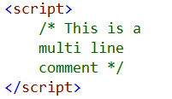
JavaScript Basics
Comments in JavaScript : There are 2 types of comments in JavaScript
1) Single Line Comment
2) Multi Line Comment
Data types in JavaScript : Numbers - 5, 5.234
Boolean - true / false
String - "MyString", 'MyString'

Slide 25
JavaScript Basics
To create a variable in JavaScript use var keyword. Variable names are case sensitive.
In c# to create an integer variable we use int keyword int X = 10;
to create a string variable we use string keyword
string str = "Hello“
With JavaScript we always use var keyword to create any type of variable. Based on the value assigned the type of the variable is inferred. var a = 10;
var b = "MyString";
In C#, you cannot assign a string value to an integer variable
int X = 10;
X = "Hello"; // Compiler error

Slide 26
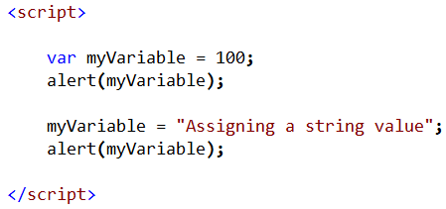
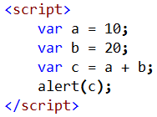
JavaScript Basics
JavaScript is a dynamically typed language. This means JavaScript data types are converted automatically as needed during script execution. Notice that, in myVariable we are first storing a number and then a string later.
When a + operator is used with 2 numbers, JavaScripts adds those numbers.
Output
30

Slide 27
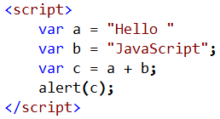
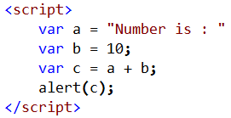
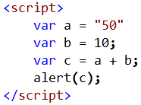
JavaScript Basics
When a + operator is used with 2 strings, JavaScript concatenates those 2 strings
When a + operator is used with a string and a number, JavaScript converts the numeric value to a string and performs concatenation.
Output
Hello JavaScript
Output
Number is 10
Output
5010

Slide 28
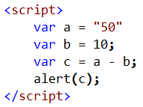
JavaScript Basics
If you use a minus operator, numeric value is not converted to string
Output
40

Slide 29
Converting strings to numbers

Slide 30
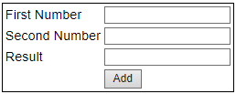
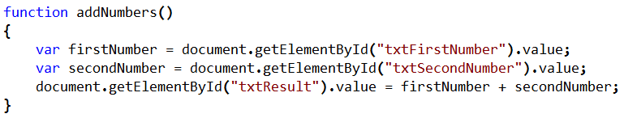
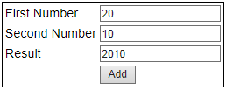
Converting Strings to Numbers
Notice that JavaScript concatenates the numbers instead of adding them. This is because the value property of the textbox is returning the number in a string format.

Slide 31
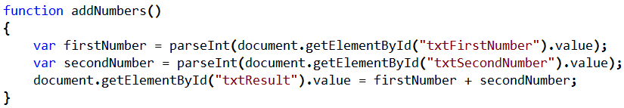
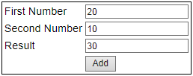
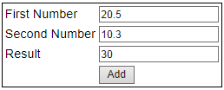
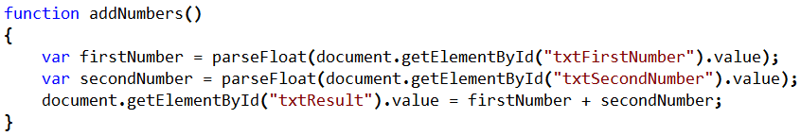
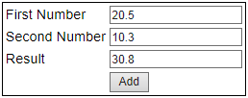
Converting Strings to Numbers
We need to explicitly do the conversion. This is when parseInt() function is useful
To retain the decimal places, use parseFloat() function
Decimal part is lost

Slide 32
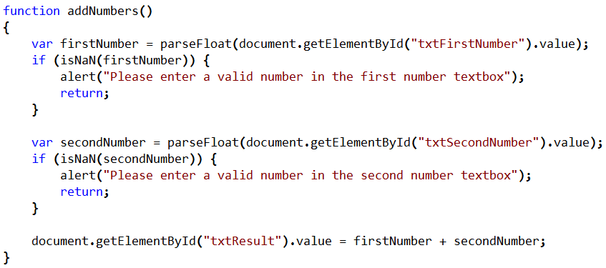
Converting Strings to Numbers
NaN in JavaScript stands for Not-a-Number. In JavaScript we have isNaN() function which determines whether a value is an illegal number. This function returns true if the value is not a number, and false if not.
Now, when you leave first number and second number textboxes blank or if you enter text instead of a number, and when you click the Add button, you get relevant validation error messages as expected

Slide 33
Converting Strings to Numbers
Let's make the validation error message a little more relevant:
If the first number and second number textboxes are left blank, then we want to display the following validation messages
a) First Number is required
b) Second Number is required
If you enter text instead of number
a) Please enter a valid number in the first number textbox
b) Please enter a valid number in the second number textbox

Slide 34
Strings in JavaScript

Slide 35


Strings in JavaScript
A string is any text inside quotes. You can use either single or double quotes
Concatenating strings : There are 2 options to concatenate strings in JavaScript. You could either use + operator or concat() method
Example : Concatenating strings using + operator
Example : Concatenating strings using concat() method
Hello JavaScript
Hello JavaScript

Slide 36
Strings in JavaScript
If you want single quotes inside a string, there are 2 options
Option 1 : Place your entire string in double quotes, and use single quotes inside the string wherever you need them
Option 2 : If you prefer to place your entire string in single quotes, then use escape sequence character \ with a single quote inside the string
Please Note : You can use the above 2 approaches if you need double quotes instead of single quotes inside a string
Welcome to 'JavaScript' Training
Welcome to 'JavaScript' Training

Slide 37



Strings in JavaScript
Converting a string to uppercase : Use toUpperCase() method
Converting a string to lowercase : Use toLowerCase() method
Length of string in JavaScript : Use length property
JAVASCRIPT
javascript
10
16

Slide 38


Strings in JavaScript
Remove whitespace from both ends of a string : Use trim() method
Replacing strings in javascript : Use replace() method. This method searches a given string for a specified value or a regular expression, replaces the specified value with the replacement value and returns a new string. This method does not change the original string
ABCD
Hello World

Slide 39
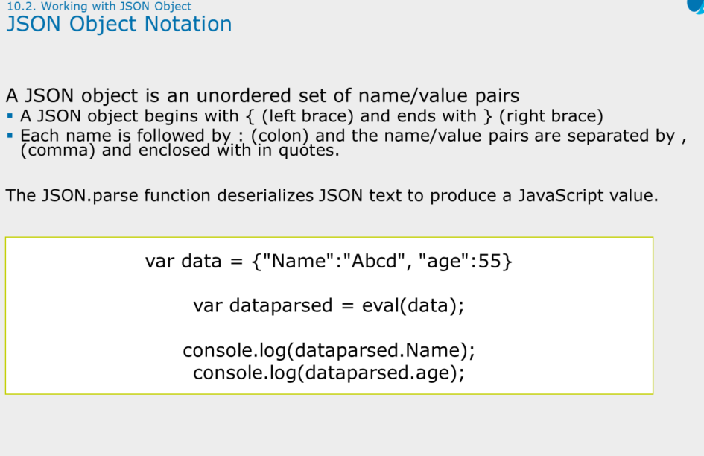

Slide 40


Strings in JavaScript
Perform a case-sensitive global replacement. In this example, we are using a regular expression between the 2 forward slashes(//). The letter g after the forward slash specifies a global replacement. The match here is case sensitive. This means Blue (with capital B) is not replaced with green.
Perform a case-insensitive global replacement. The letters gi after the forward slash indicates to do global case-insensitive replacement. Notice that the word Blue(with capital B) is also replaced with green.
A Blue bottle with a green liquid is on a green table
A green bottle with a green liquid is on a green table

Slide 41
Substrings in JavaScript

Slide 42
Substrings in JavaScript
3 methods in JavaScript that can be used to retrieve a substring from a given string
substring()
substr()
slice()
substring() method : This method has 2 parameters start and end. start parameter is required and specifies the position where to start the extraction. end parameter is optional and specifies the position where the extraction should end. The character at the end position is not included in the substring. If the end parameter is not specified, all the characters from the start position till the end of the string are extracted.
If the value of start parameter is greater than the value of the end parameter, this method will swap the two arguments. This means start will be used as end and end will be used as start.

Slide 43


Substrings in JavaScript
Extract the first 10 characters
If the value of start parameter is greater than the value of the end parameter, then start will be used as end and end will be used as start
substr() method : This method has 2 parameters start and count. start parameter is required and specifies the position where to start the extraction. count parameter is optional and specifies the number of characters to extract.
If the count parameter is not specified, all the characters from the start position till the end of the string are extracted. If count is 0 or negative, an empty string is returned.
JavaScript
JavaScript

Slide 44


Substrings in JavaScript
Extract the first 10 characters
If the count parameter is not specified, all the characters from the start position till the end of the string are extracted
slice() method : This method has 2 parameters start and end. start parameter is required and specifies the position where to start the extraction. end parameter is optional and specifies the position where the extraction should end. The character at the end position is not included in the substring.
If the end parameter is not specified, all the characters from the start position till the end of the string are extracted.
JavaScript
Tutorial

Slide 45


Substrings in JavaScript
Extract the first 10 characters
If the end parameter is not specified, all the characters from the start position till the end of the string are extracted
What is the difference between substr and substring methods
The difference is in the second parameter. The second parameter of substring() method specifies the index position where the extraction should stop. The character at the end position is not included in the substring. The second parameter of substr() method specifies the number of characters to return.
Another difference is substr() method does not work in IE8 and earlier versions.
JavaScript
Tutorial

Slide 46

Substrings in JavaScript
What is the difference between slice and substring
If start parameter is greater than stop parameter, then substring will swap those 2 parameters, where as slice will not swap.
Another method that is very useful when extracting a substring is indexOf() method. This method returns the position of the first occurrence of a specified value in a string. If the specified value is not present then -1 is returned.
Example : Retrieve the index position of @ character in the email
In our next video, we will discuss a simple real time example of where we can use indexOf() and substring() methods
6

Slide 47
Conditional Statements

Slide 48
Conditional Statements in JavaScript
JavaScript code is executed from the first line to the last line. If for some reason you want to interrupt this flow and execute certain statements, only, if certain condition is met, then we use conditional statements.
JavaScript has the following conditional statements
if
if else
if else if else
switch
ternary operator - shortcut for an if...else statement

Slide 49
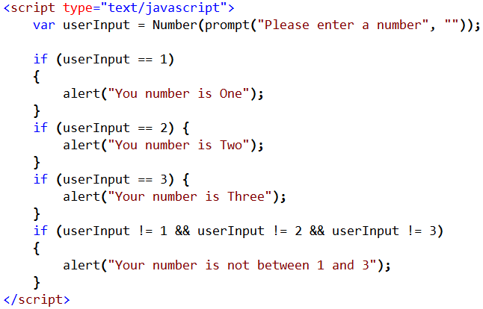
Conditional Statements in JavaScript

Slide 50
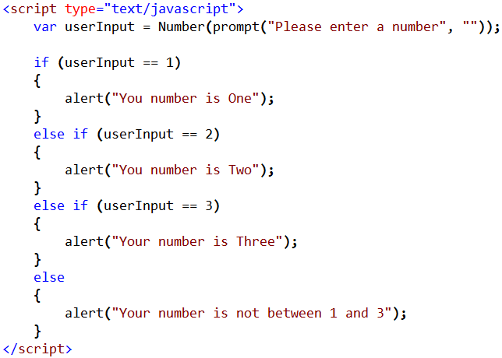
Conditional Statements in JavaScript

Slide 51
Switch Statement

Slide 52
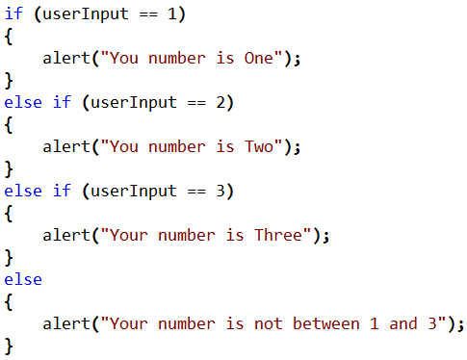
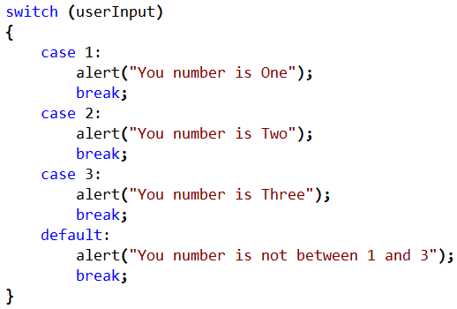
Switch Statement in JavaScript
When should we use switch statement
To improve the readability of a program multiple if else if statements can be replaced with a switch statement

Slide 53
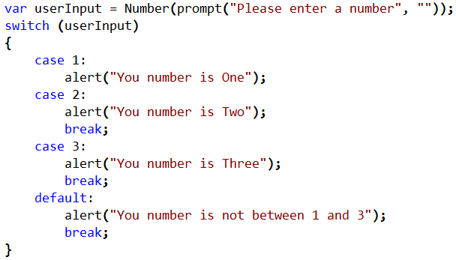
Switch Statement in JavaScript
In general we need to have break statement after each case statement to ensure the program breaks out of the switch statement after executing statements present in a specific case.
What happens if there is no break in a switch statement?
If there is no break statement the execution falls automatically to next case until a break statement is encountered or end of the program is reached.
In the example, since we don't have a break statement for case 1, when we enter 1 as the number we would get 2 alerts. First alert from case 1 and the second alert from case 2.

Slide 54
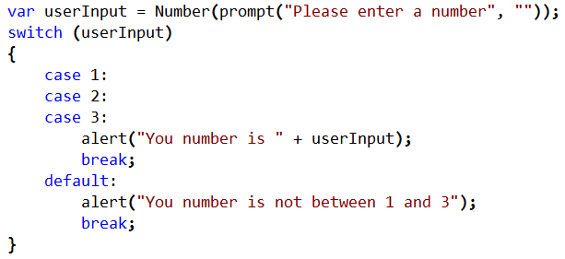
Switch Statement in JavaScript
When would you combine multiple case statements together?
If you want the same piece of code to be executed for multiple cases you can combine them together. Case statement with no code in-between creates a single case for multiple values. A case without any code will automatically fall through to the next case.
In this example case 1 and case 2 will fall through and execute code for case 3

Slide 55
Ternary Operator

Slide 56
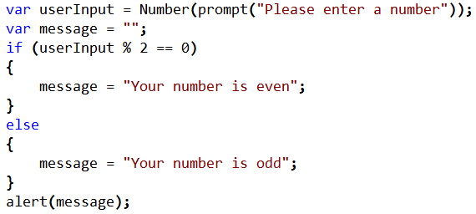
Ternary Operator in JavaScript
Ternary operator can be used as a shortcut for if...else... statement
Syntax
Boolean Expression ? Statements to execute if true : Statements to execute if false
Checks if the number is even or odd using if...else... Statement

Slide 57
Ternary Operator in JavaScript
Checks if the number is even or odd using ternary operator
Can we have multiple statements per case with a ternary operator
Yes, we can put the multiple statements in a bracket and separate them with a comma

Slide 58
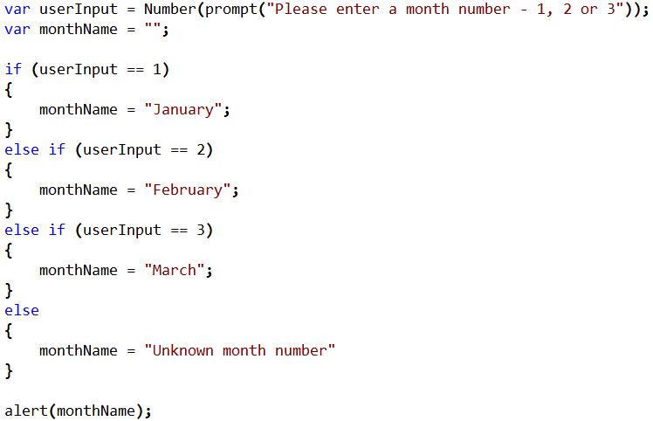
Ternary Operator in JavaScript
Multiple if… else if... statements can be replaced with ternary operator
Display the month name based on the month number using if...else if... Statement

Slide 59
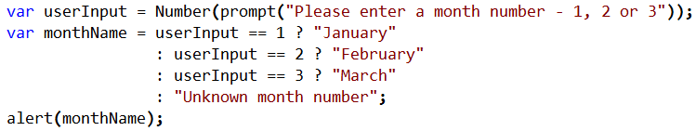
Ternary Operator in JavaScript
Display the month name based on the month number using ternary operator
Please Note : if...else if... statements are replaced with ternary operator

Slide 60
JavaScript while loop

Slide 61
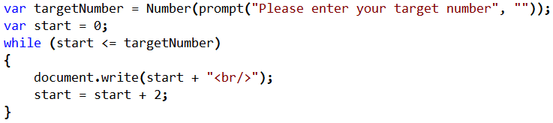
Loops in JavaScript - while loop
Basic loops in JavaScript
while
do...while
For
Print all even numbers from ZERO till the target number provided
How does the while loop work 1. While loop checks the condition first
2. If the condition is true, statements with in the loop are executed
3. This process is repeated as long as the condition evaluates to true

Slide 62
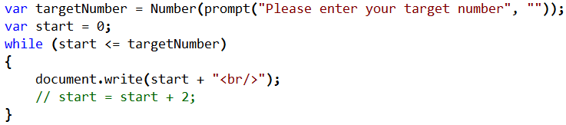
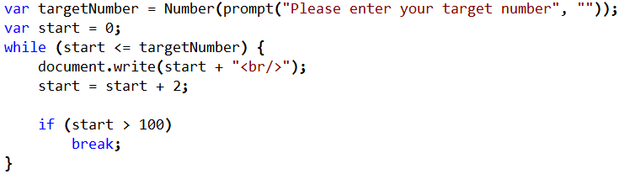
Loops in JavaScript - while loop
Infinite while loop : Failure to update the variable that participates in the condition will create a never ending or infinite loop.
What is the use of break statement
If break statement is used in a switch statement, it causes the execution to break out of that switch statement. In a similar fashion, if used in a loop, the loop ends.

Slide 63
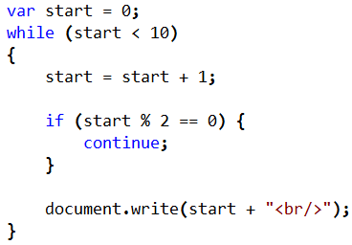
Loops in JavaScript - while loop
What is the use of continue statement
Continue statement tells the JavaScript interpreter to skip remaining code that is present after this statement and start the next iteration of the loop
Example : Print all odd numbers between 1 and 10

Slide 64
Q & A
Contact:rashmipawaskar@synergetics-india.com

Slide 65
Thank You

